Slide 1
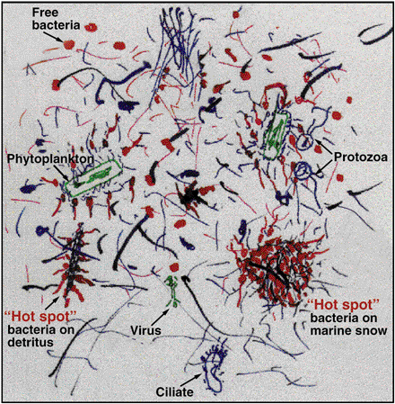
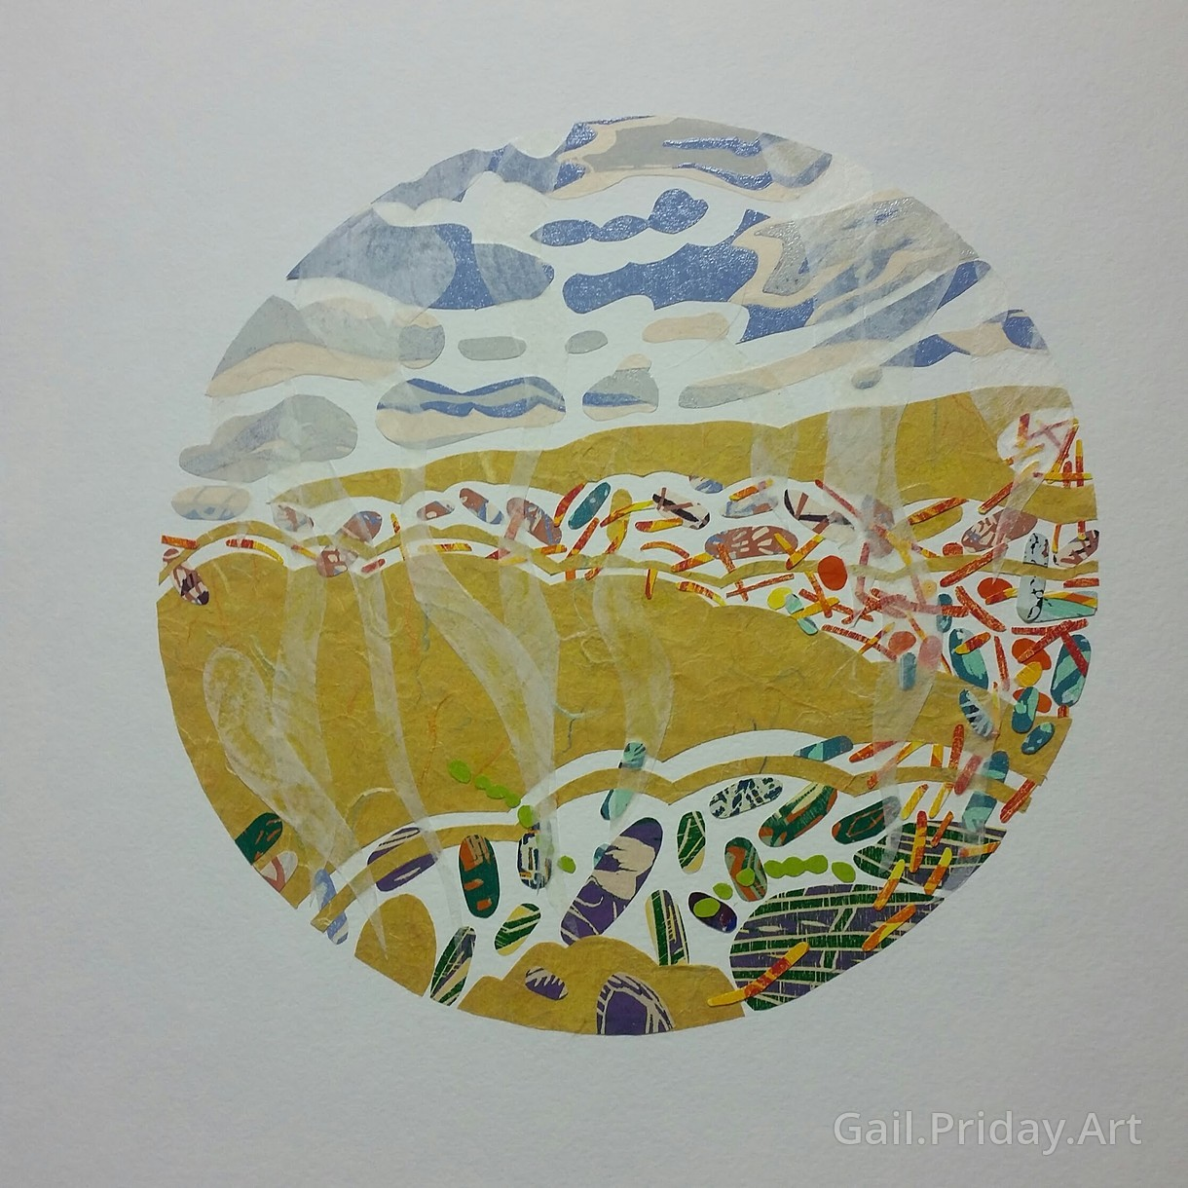
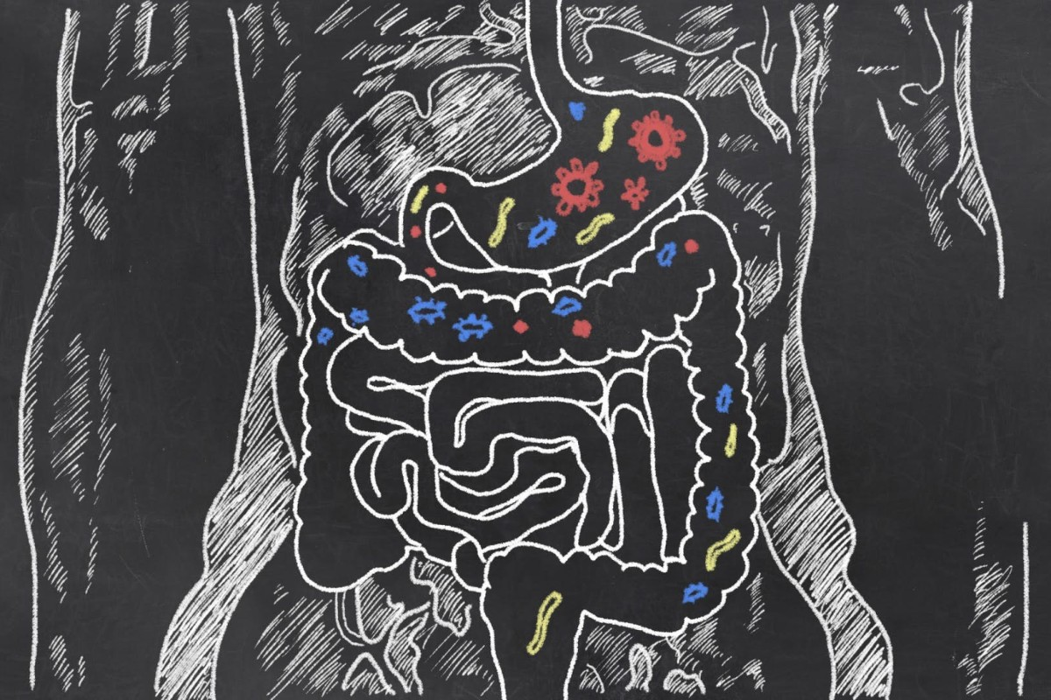
Metagenomics Lesson 5: Sequence Assembly

Slide 2
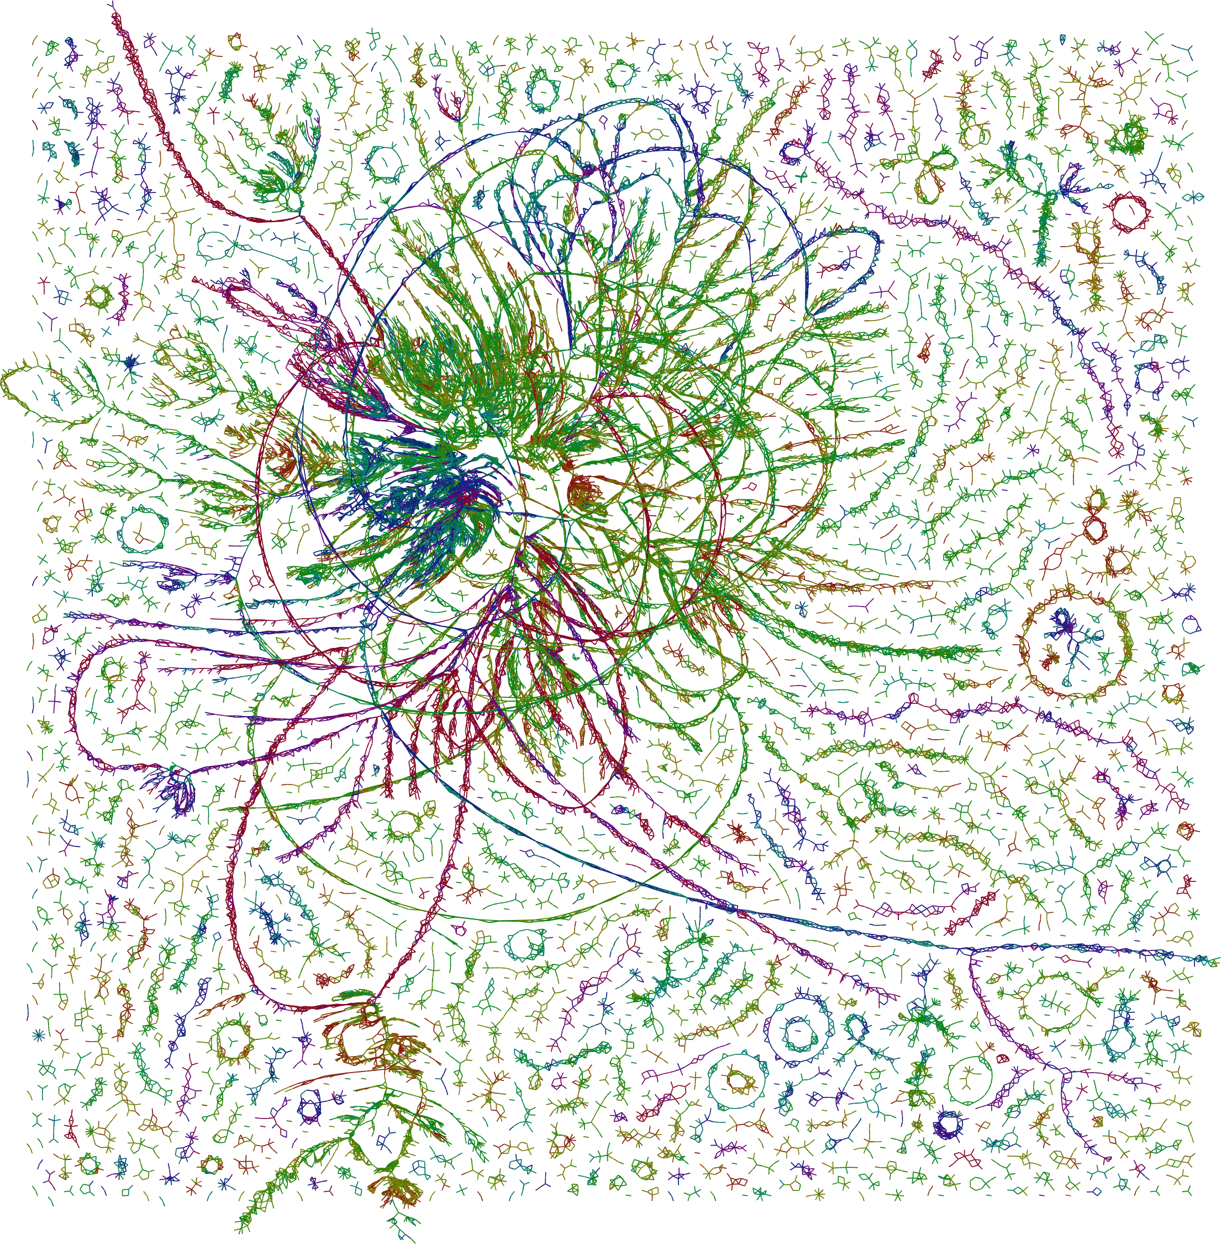
Metagenomics Lesson 5
Sequence Assembly
Sequencing Diverse Samples
Sequencing Statistics
Assembly Paradigms
Overlap - Layout - Consensus
de Bruijn Graph
Long-read
Hybrid
Assembly Software

Slide 3
Working with Short-read Metagenomic Data
Different colors correspond
to different species:
Do we have enough coverage to piece together a “red” genome?
Notes:
Frank slide
‹#›

Slide 4
Coverage depends on genome relative abundance
genomic library
4 dominant species
G
E
N
O
M
E
C
O
V
E
R
A
G
E
Abundant species >> moderately abundant species > rare species
10X coverage of species 1
0.5X coverage of species 4
Abundant groups: Draft Genome Assembly Possible
Rare groups: Only Read-Based Analysis Possible
Notes:
‹#›
Mostly a Frank slide

Slide 5
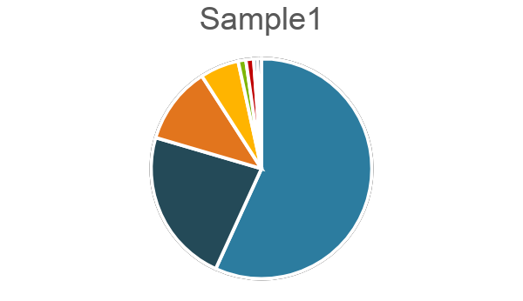
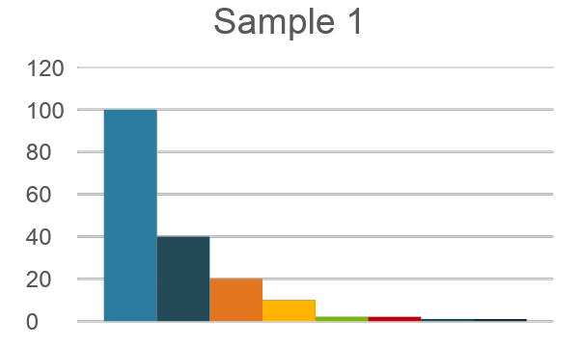
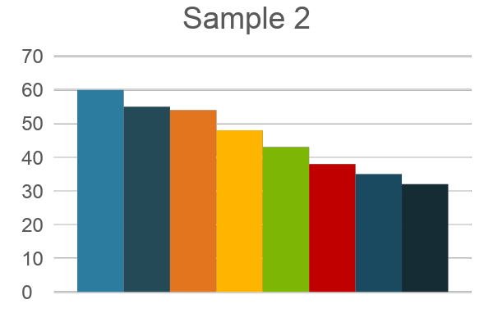
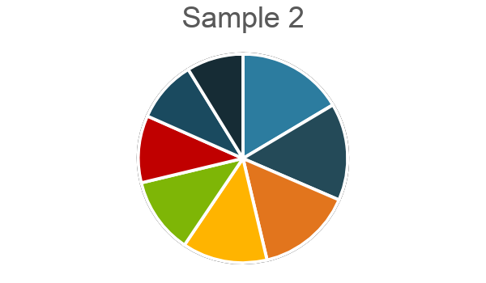
Effects of Evenness on Coverage
Community abundance
DNA Pool
Determining the Rank-Abundance Relationship for a Community:
Before sequencing one can estimate community richness/evenness with
SSU libraries, FISH, or other techniques
Sample 1:
Less Even = Lower sequencing demand for abundant groups
Sample 2: More Even = Higher sequencing demand for abundant groups
Notes:
‹#›
Frank slide

Slide 6
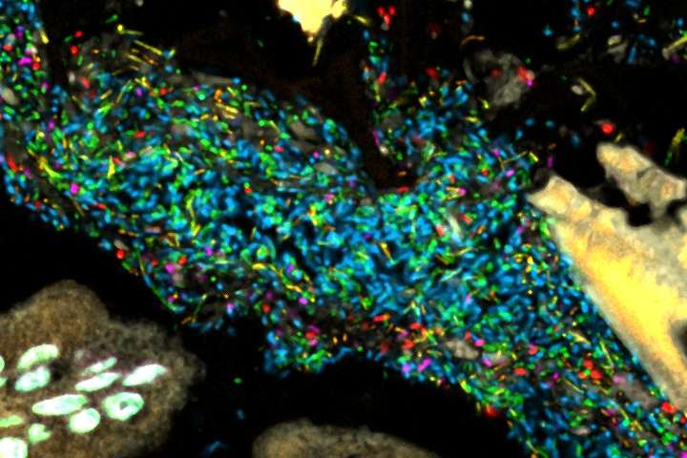
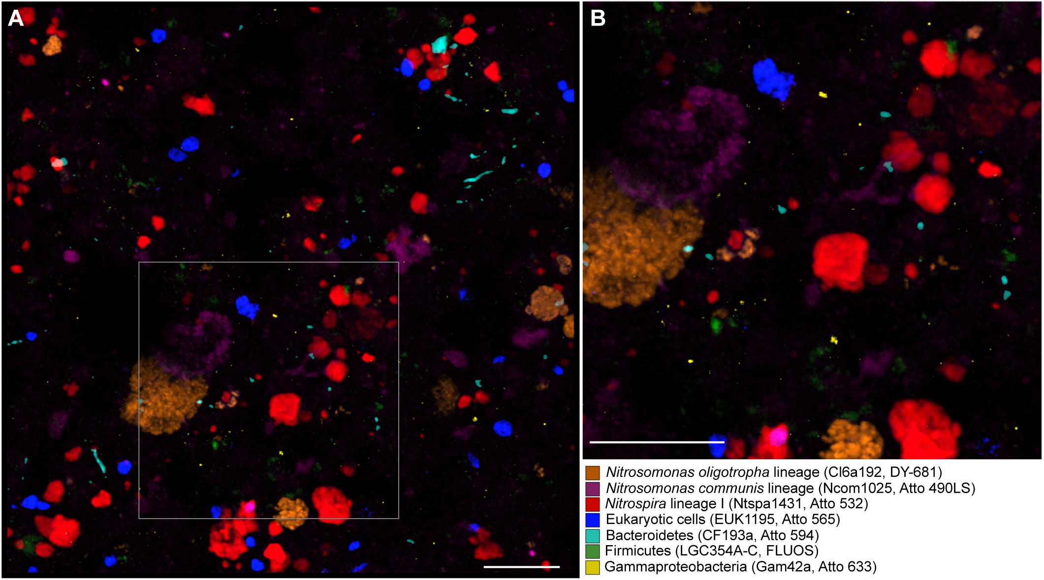
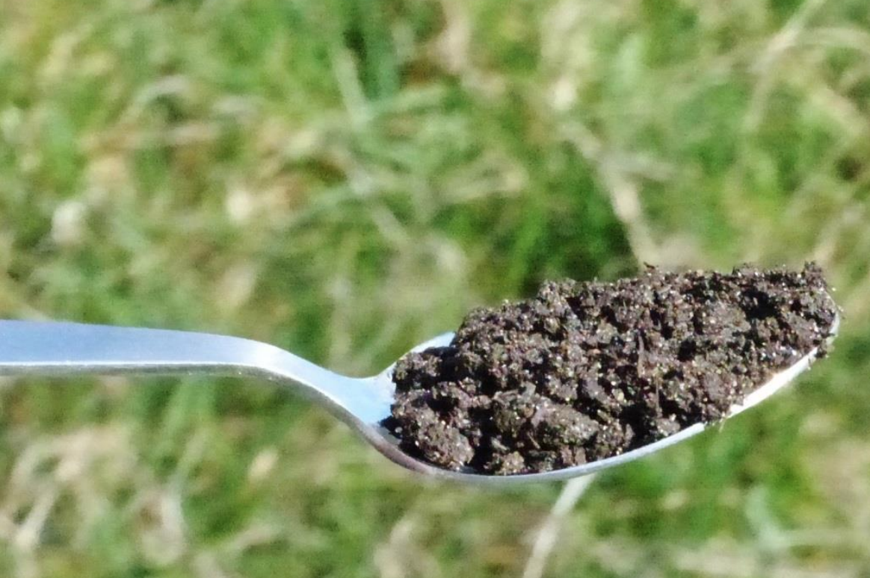
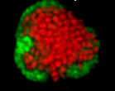
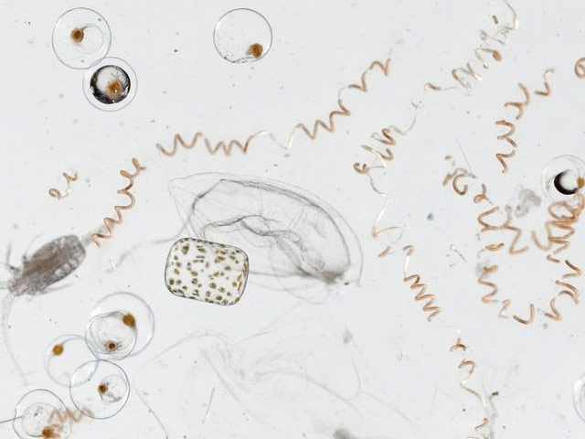
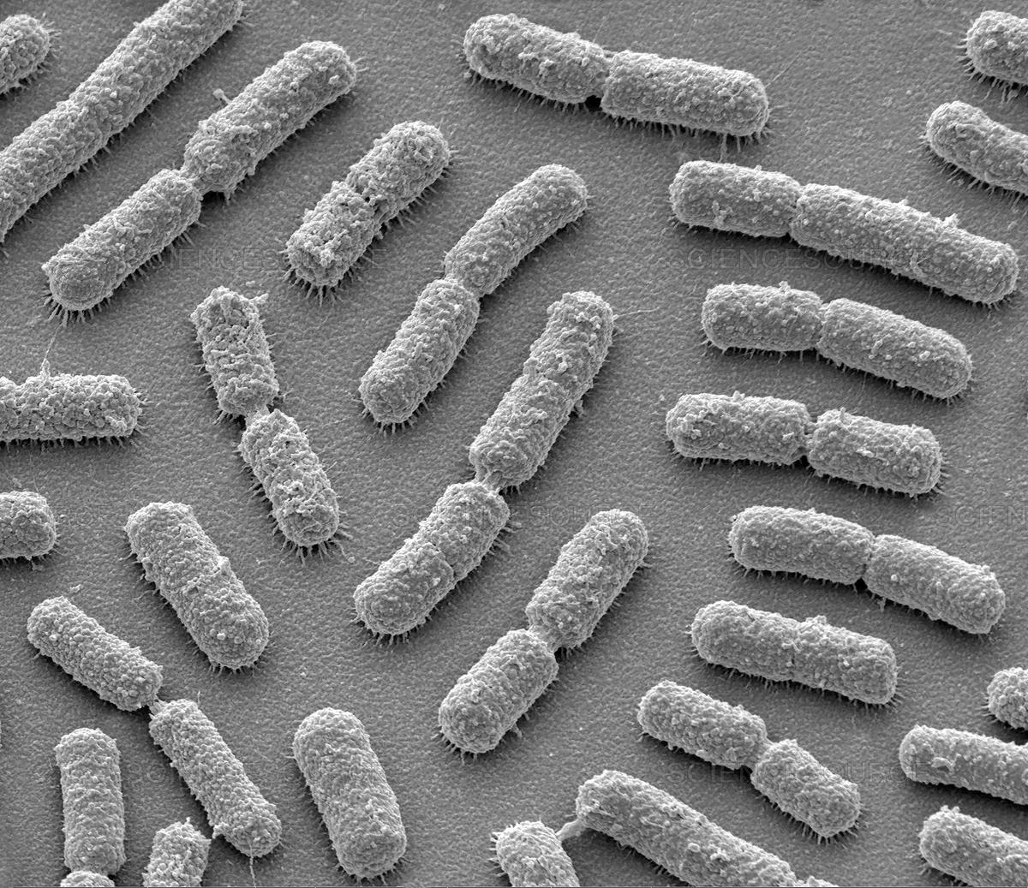
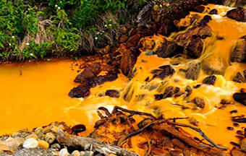
Gradients in diversity
High diversity habitats are more amenable to read-based analysis
Different Environments Require
Different Approaches for Evaluating
Microbial Diversity and Physiology
Low diversity habitats are more amenable to assembly based analysis
Notes:
‹#›
Modified Allen slide

Slide 7
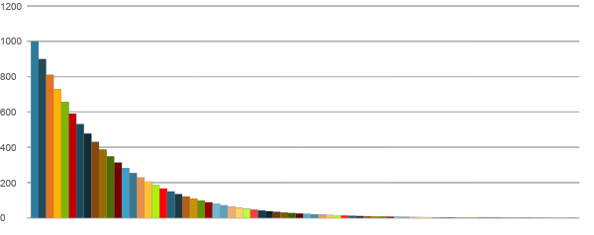
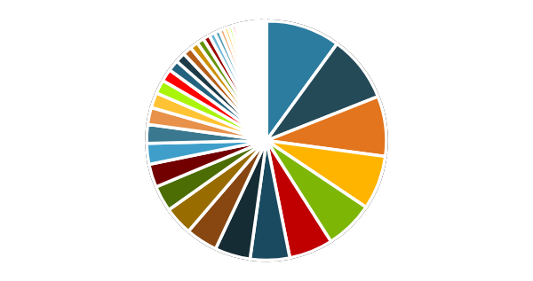
High-Complexity Environments
Targeting low-abundance populations becomes very difficult without some kind of enrichment (single cell, cell sorting, etc.)
Taxonomic profile
Abundance
Notes:
‹#›
Frank slide

Slide 8
Sequencing Statistics: What is Coverage?
Q: What is the average read coverage?
Coverage C = LN / G
L is the read length
N is the number of reads
G is the haploid genome length
Example: You sequence E. coli using a whole MiSeq 2x250bp run
C = 250 * 8M / 4M =
500x coverage on average
Genomes are randomly* sheared during DNA extraction and library prep
During sequencing, a random subset of the fragments are sampled

Slide 9
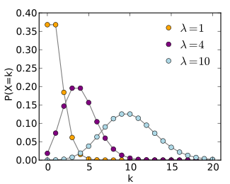
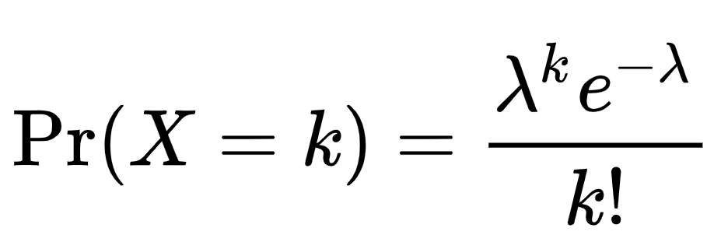
Sequencing Statistics: The Poisson Distribution
Q: What is the probability that a base will be sequenced exactly 0 times given a coverage of 4?
A: Ask Poisson!
k = times base is seen, ƛ = average coverage
Pr(X=0) = 4^0 * exp(-4)/0! = 0.0183 = 1.83%

Slide 10
Sequencing Statistics: Coverage Goals
Q: What is the probability that a base will be sequenced 2 times or less given a coverage of 4?
A: Pr(X=0) + Pr(X=1) + Pr(X=2)
= 0.0183 + 0.0732 + 0.1465 = 0.2380 = 23.8%
We’ll want to do better than this!
k = times base is seen, ƛ = average coverage

Slide 11
Sequencing Statistics: No Base Left Behind
Q: What is the minimum coverage of E. coli needed to ensure (statistically) that no bases are left unsequenced?
A: Pr(X < 1/4,000,000) 1/4E6 = C^0 * exp(-C)/0!
1/4E6 = 1 * exp(-C)/1 C = -ln(1/4E6) C > 15
k = times base is seen, ƛ = average coverage

Slide 12
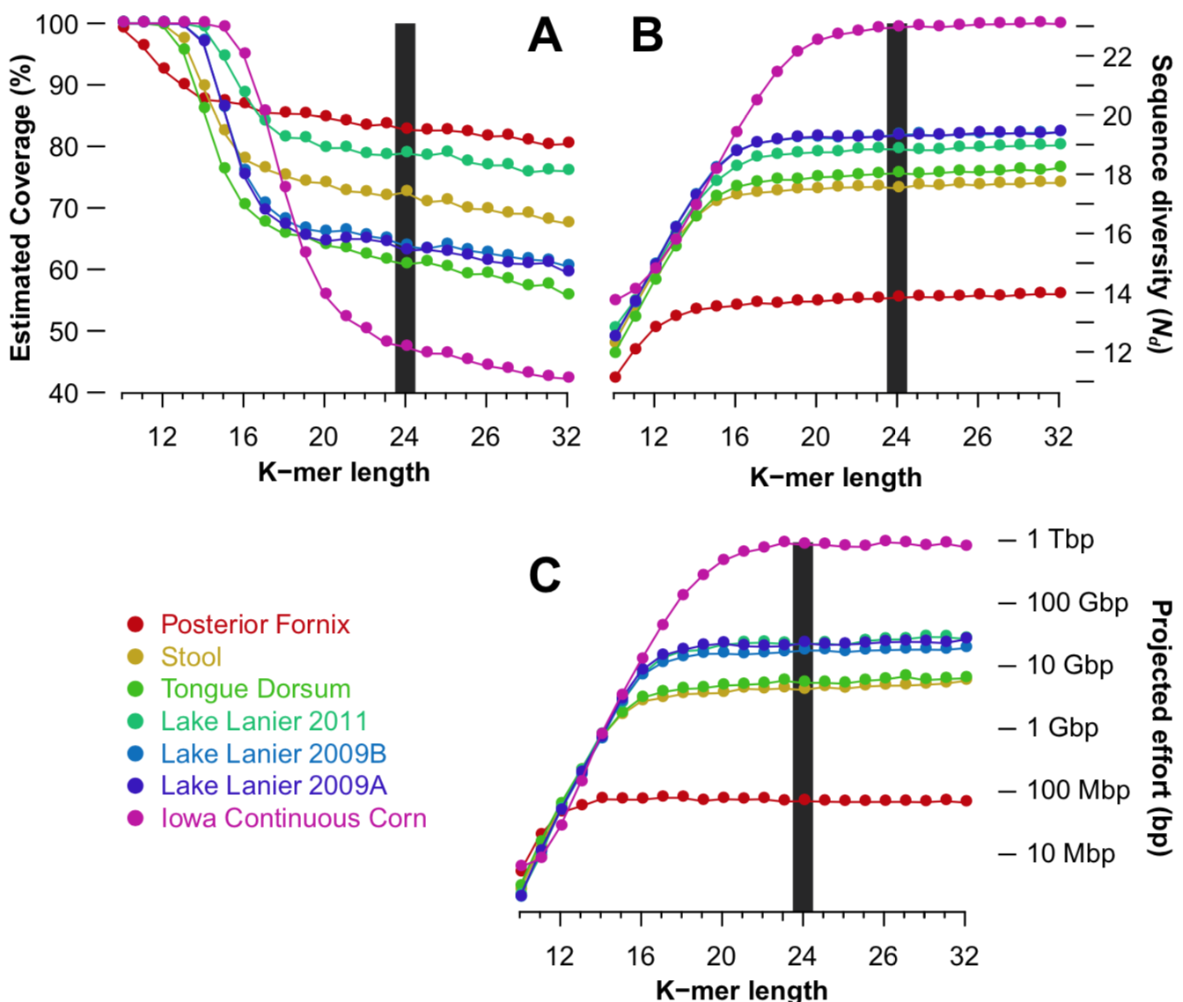
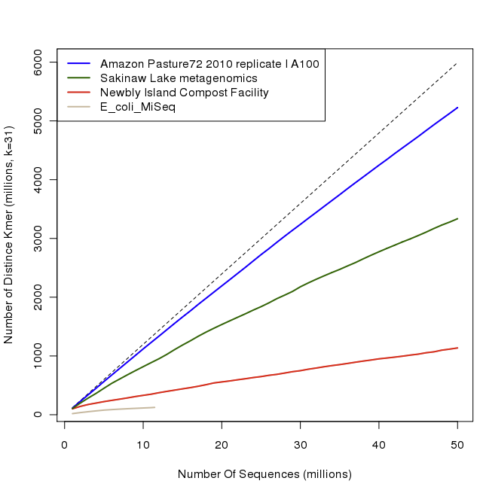
Metagenome Coverage:
There’s always more k-mers?
Nonpareil-k, Rodriguez et al. 2018 https://msystems.asm.org/content/3/3/e00039-18
to reach 95% coverage
https://ngscc.blogspot.com/2012/06/kmer-rarefaction.html

Slide 13
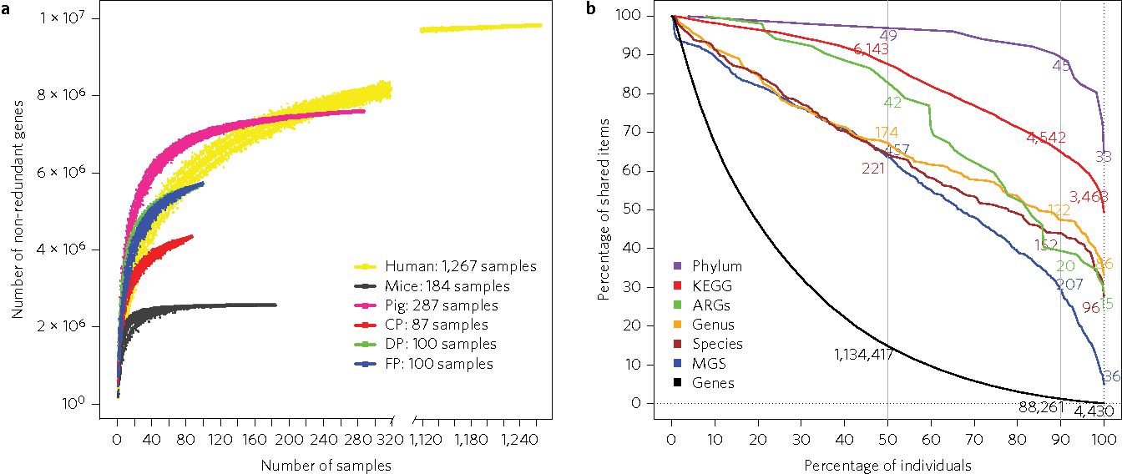
Metagenome Coverage: Always more genes and taxa?
Xiao et al. 2016 https://www.nature.com/articles/nmicrobiol2016161

Slide 14
Sequence Assembly Methods: Software
OLC: Overlap-Layout-Consensus
Originally designed for high quality long reads from Sanger sequencing
Used mostly for eukaryotes (?)
MIRA
Celera
MaSuRCA
Newbler
Allora
Arachne
AMOS
Meraculous
Opera
de Bruijn Graph
Optimized for high-ish quality short reads from Illumina sequencing
Used for prokaryotes and metagenomes
SPAdes
MegaHIT
IDBA
Minia
Ray Meta
SOAPdenovo
Velvet/Velour
ABySS
Long-read assemblers
Optimized for low quality long reads from PacBio/Nanopore sequencing
Canu (Celera fork)
Flye
Miniasm/Minipolish
Raven
Redbean
Shasta
Notes:
‹#›
Allen slide

Slide 15
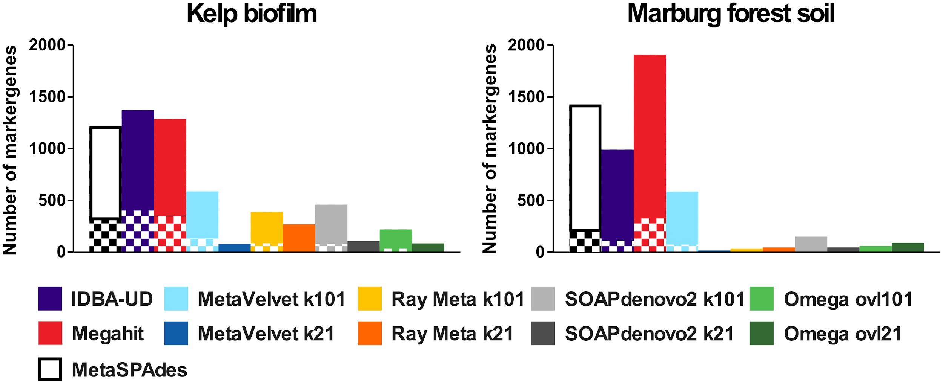
Sequence Assembly Methods: Software Comparison
Vollmers et al. 2017

Slide 16
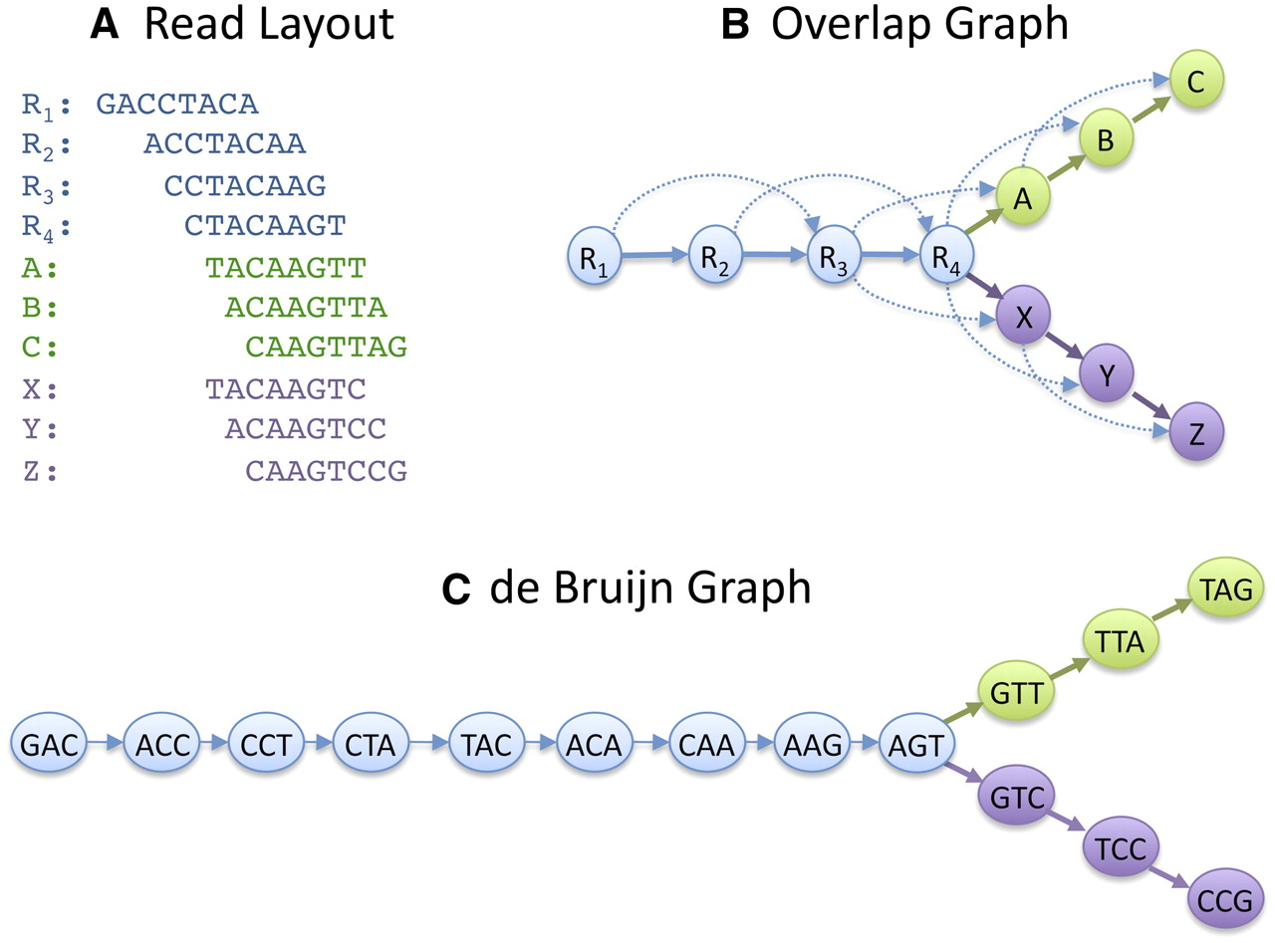
Sequence Assembly Methods: Theory
min overlap = 5
nodes = 10
edges = 17
singletons = 1
R1: GACCTACA
R2: ACCTACAA
R3: CCTACAAG
R4: CTACAAGT
S: GACGTACA
A: TACAAGTT
B: ACAAGTTA
C: CAAGTTAG
X: TACAAGTC
Y: ACAAGTCC
Z: CAAGTCCG
S
k = 3
nodes = 18
edges = 18
singletons = 0
ACG
CGT
GTA
After Schatz et al. 2010
Notes:
Is S a SNP or an error? Do you want the assembler to treat them differently?

Slide 17
Overlap-Layout-Consensus Assembly
…GATCATACATTCACATACAC…
contiguous DNA fragment
overlap
individual sequencing reads
Assembly is greatly complicated by sequence heterogeneity and gaps in coverage due to undersampling.
Unassembled reads that do not find overlap are “singletons”
Notes:
‹#›

Slide 18
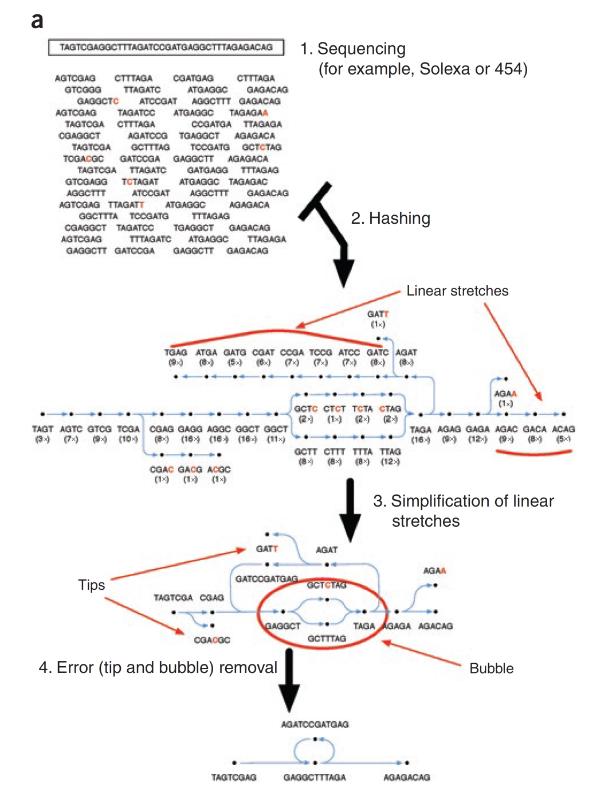
de Bruijn Graph Assembly
Index k-mers in reads
k = 21 - 127 is typical
Collect k-mers into nodes
Record coverage of each node
Rescue “mercy” k-mers that would be lost by coverage limits
Flag repeats and errors by anomalous coverage
Assemble prefix & suffix nodes to create edges
Simplify graph by collapsing nodes into linear stretches
Find a path or trail that visits each edge once
Traverse optimal path to reconstruct consensus sequence
Flicek & Birney (2009) Nature Methods 6:S6
Notes:
‹#›

Slide 19
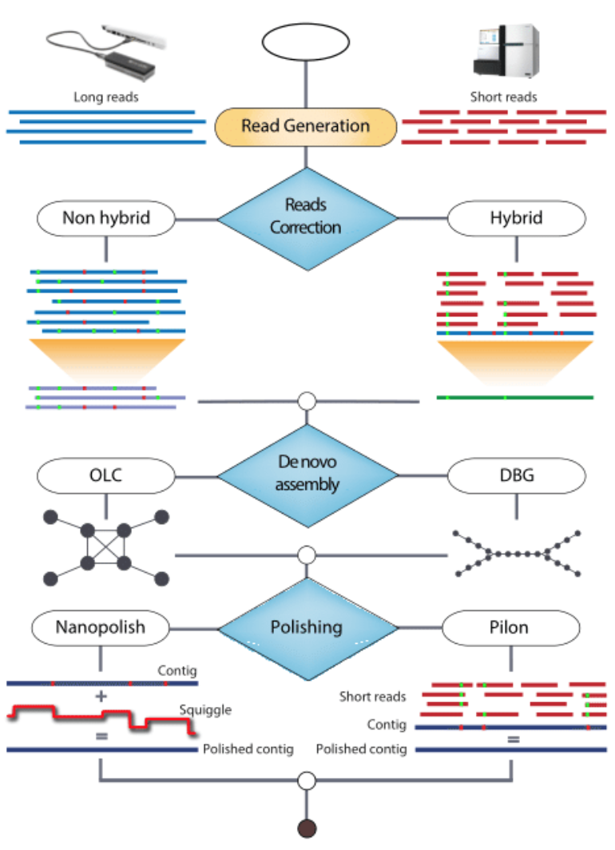
Long-read Assembly
Long-read (multi-kbp) sequences from Nanopore and PacBio suffer from high error rates, so two options for good assemblies:
Hybrid: Use long reads as scaffolds to resolve repeats from the short-read assembly
De novo: These methods use high coverage of long reads to resolve errors. Can also use short reads for ‘polishing’ completed assembly.
Magi et al (2018) Briefings in Bioinformatics

Slide 20
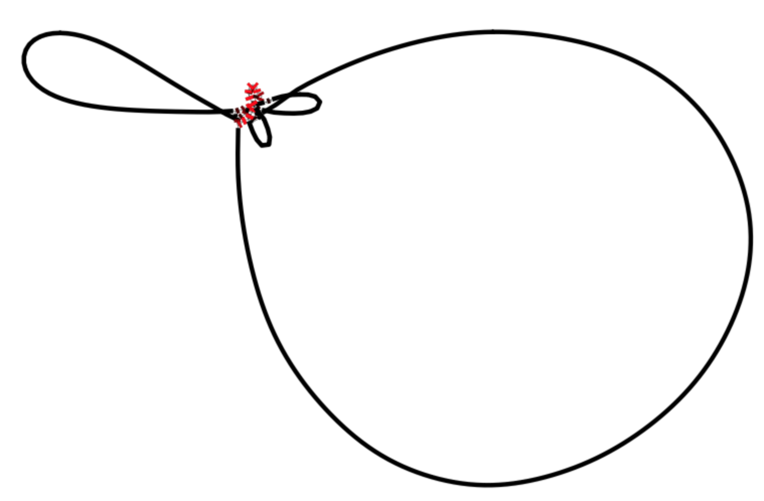
Meta/Genome Assembly
Parameterization + Iteration = Success!
minimum length of overlap
k-mer length
mismatch penalties
gap penalties
minimum quality score
contig merge stringency
…and many more…
The output of assembly programs include contigs, scaffolds, and assembly graphs
If you’re doing genome sequencing,
always look at your assembly graphs!
Notes:
‹#›
Allen Slide

Slide 21
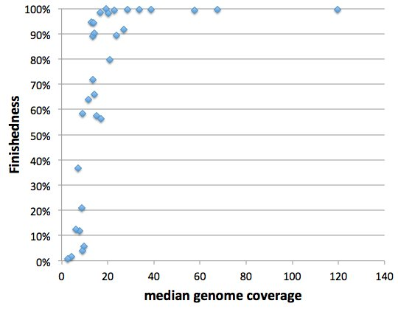
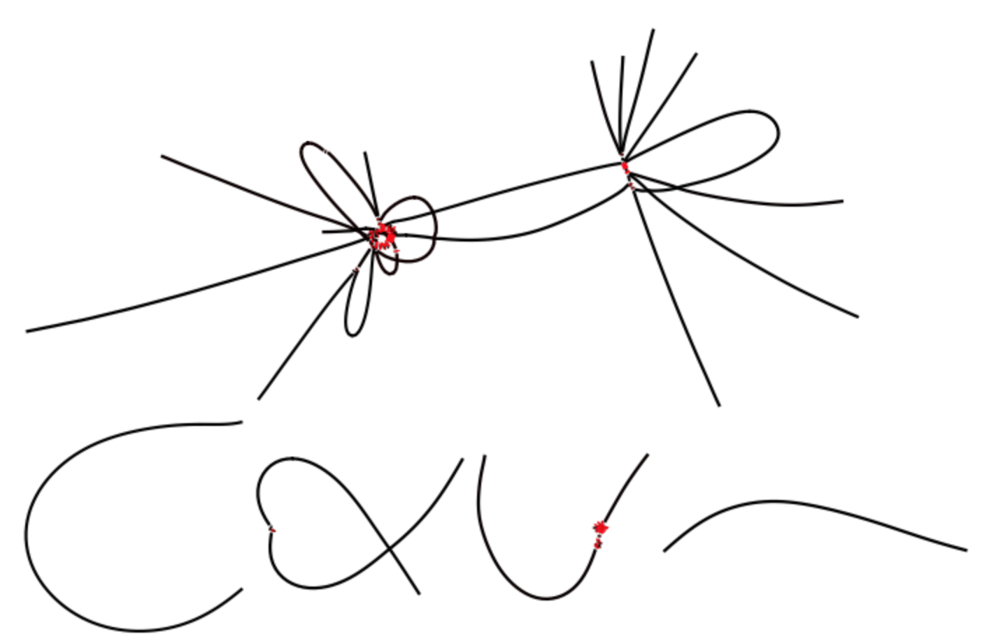
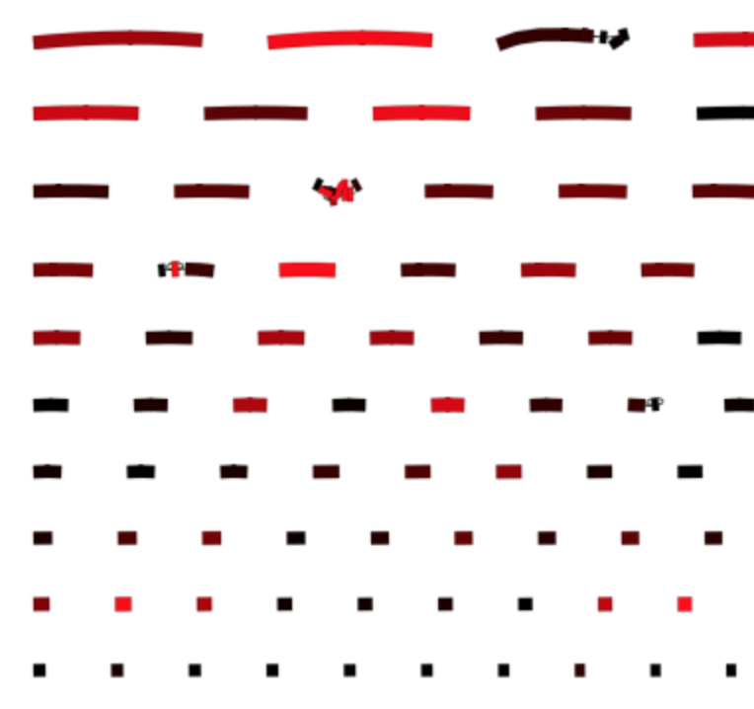
Genome Assembly: “Finishedness”
“Finishedness” (a term I made up) = size of largest connected component/total size of assembly
In real data, 30-40x coverage can be needed to get “perfect” assemblies due to sequencing error, biased library preparation methods, variations in DNA content due to exponential growth, or other mysterious reasons.

Slide 22
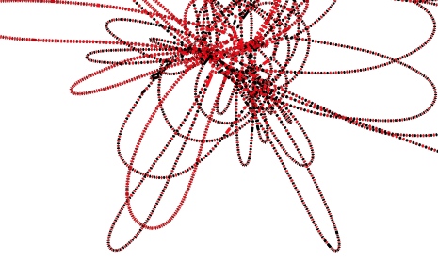
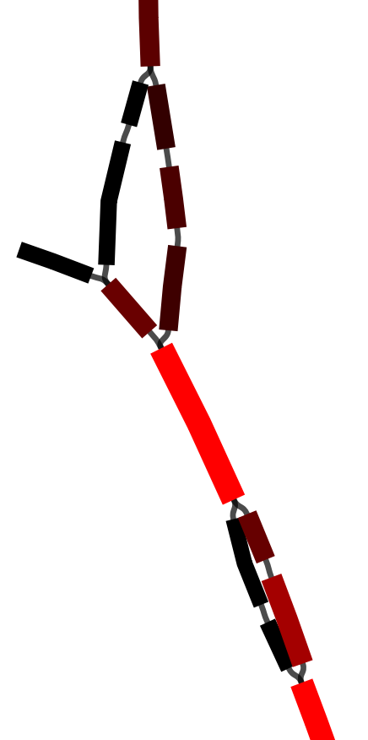
de Bruijn Graph Co-Assembly of Two Closely Related Genomes
red = high coverage
black = low coverage
tip
bubble
bubble
Visualized in Bandage (Wick et al. 2015)
Notes:
‹#›

Slide 23
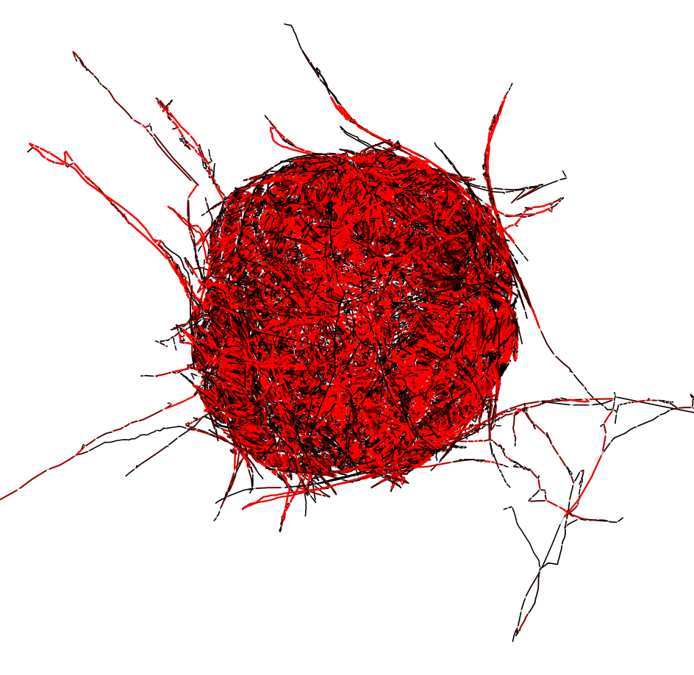
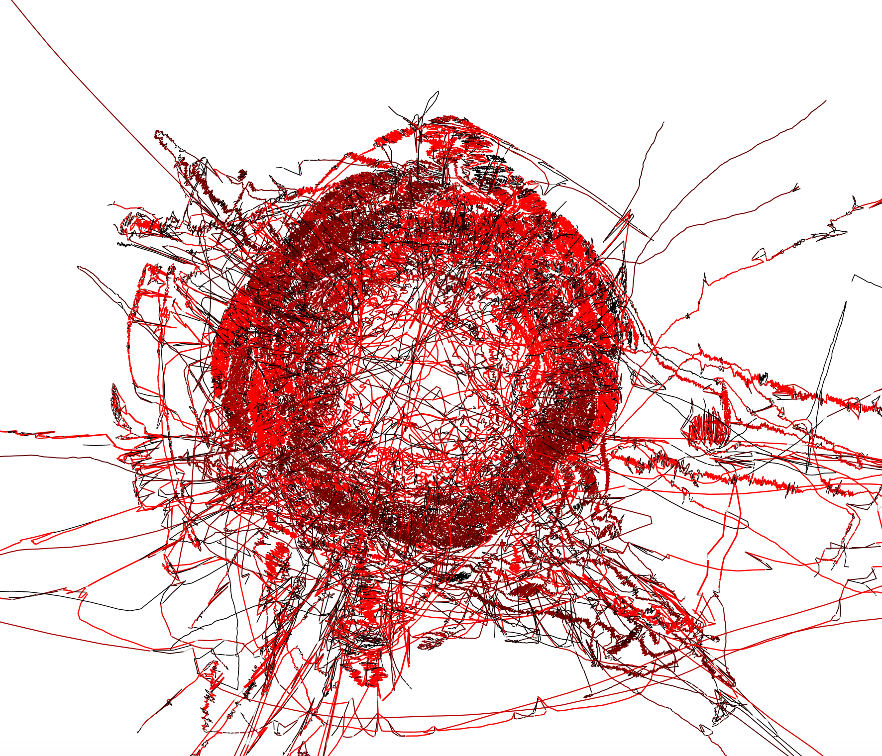
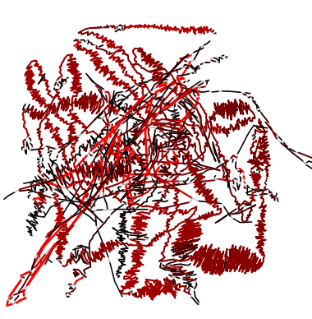
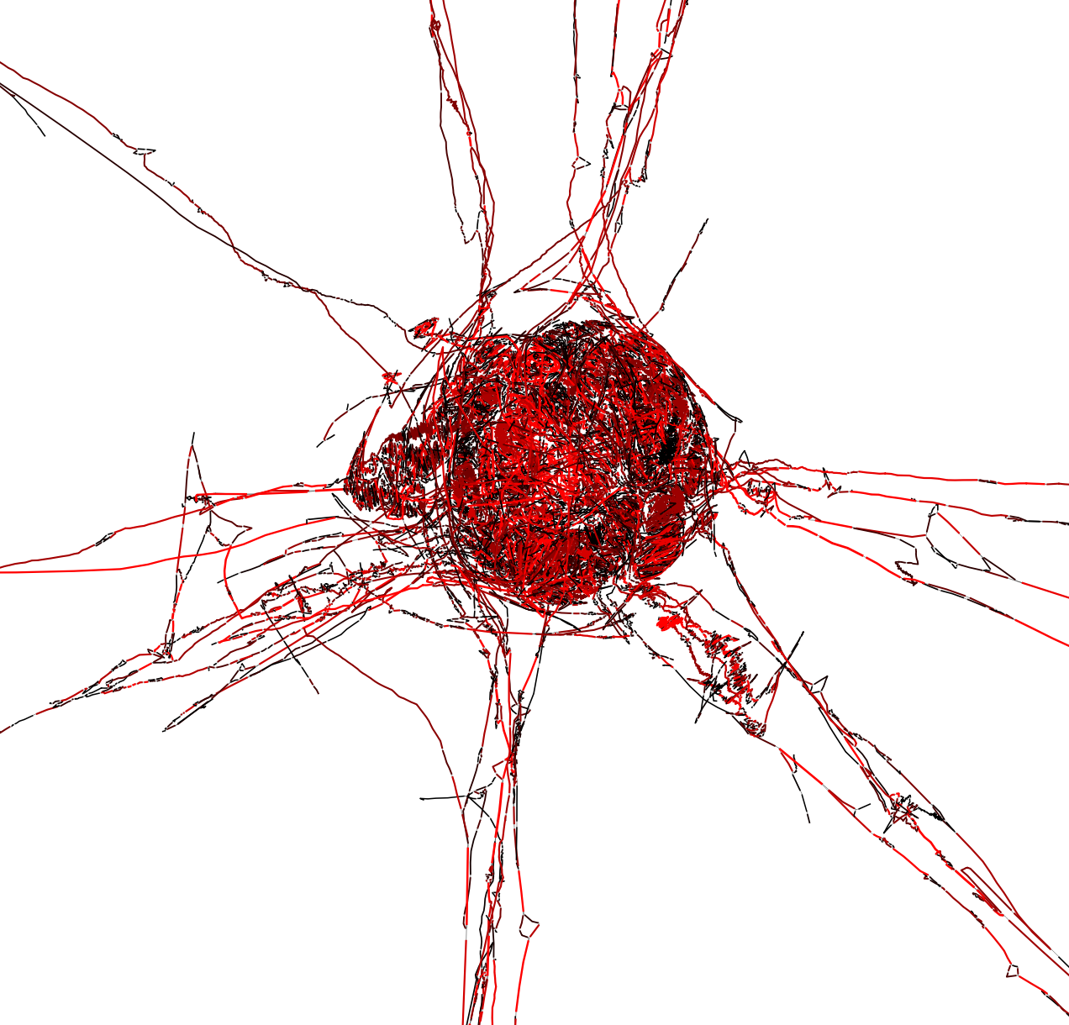
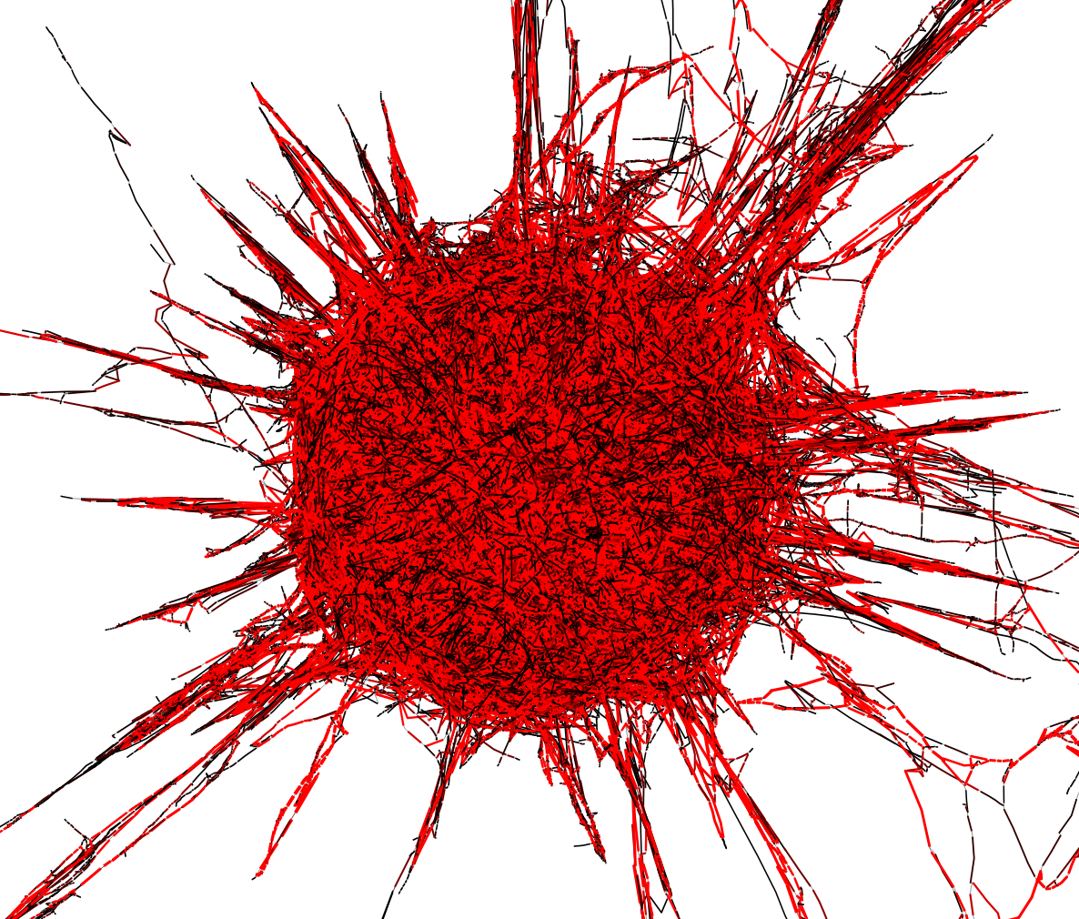
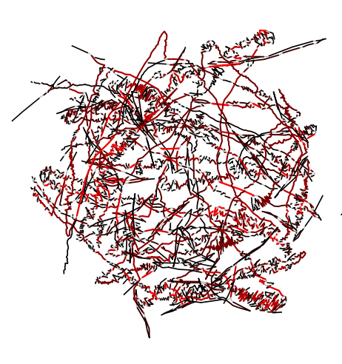
Portraits from a 100 Mbp metagenome assembly

Slide 24
Resources
Will Trimble: All kmers are not created equal
https://www.slideshare.net/wltrimbl/all-kmers-are-not-created-equal-recognizing-the-signal-from-the-noise-in-largescale-metagenomes
Rob Edwards Genome Assembly videos
https://www.youtube.com/playlist?list=PLbHoaEmUsmfUXxTTGsL163rmeR8_qCY9F
Megahit definition of mercy k-mers
https://github.com/voutcn/megahit/issues/86
CAMI: Critical Assessment of Metagenome Interpretation
https://data.cami-challenge.org/
https://www.nature.com/articles/nmeth.4458

Slide 25
Demo 5.1 Genome Assembly using SPAdes
Binder for demo
https://mybinder.org/v2/gh/biovcnet/metagenomics-binder-assembly/master?urlpath=lab
Bash script
https://github.com/biovcnet/topic-metagenomics/blob/master/Lesson-5/Demo5.1_spades.sh

